Slide 1

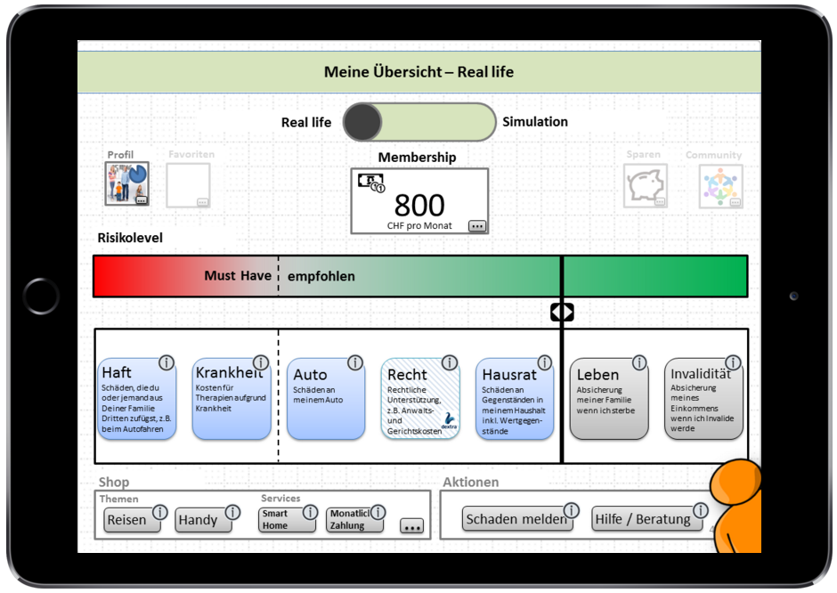
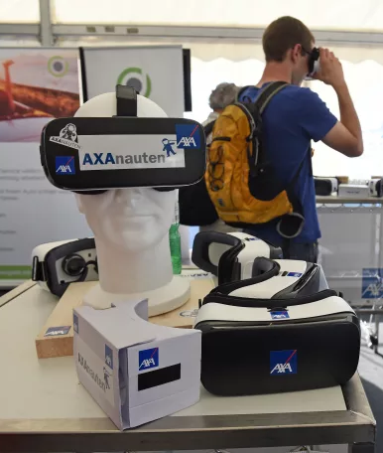
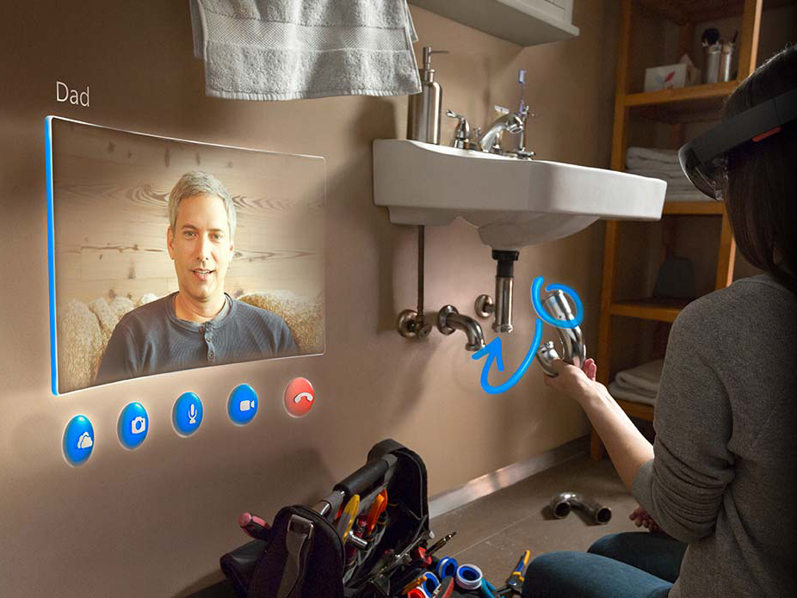
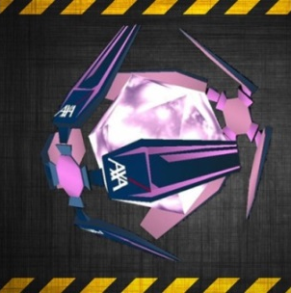
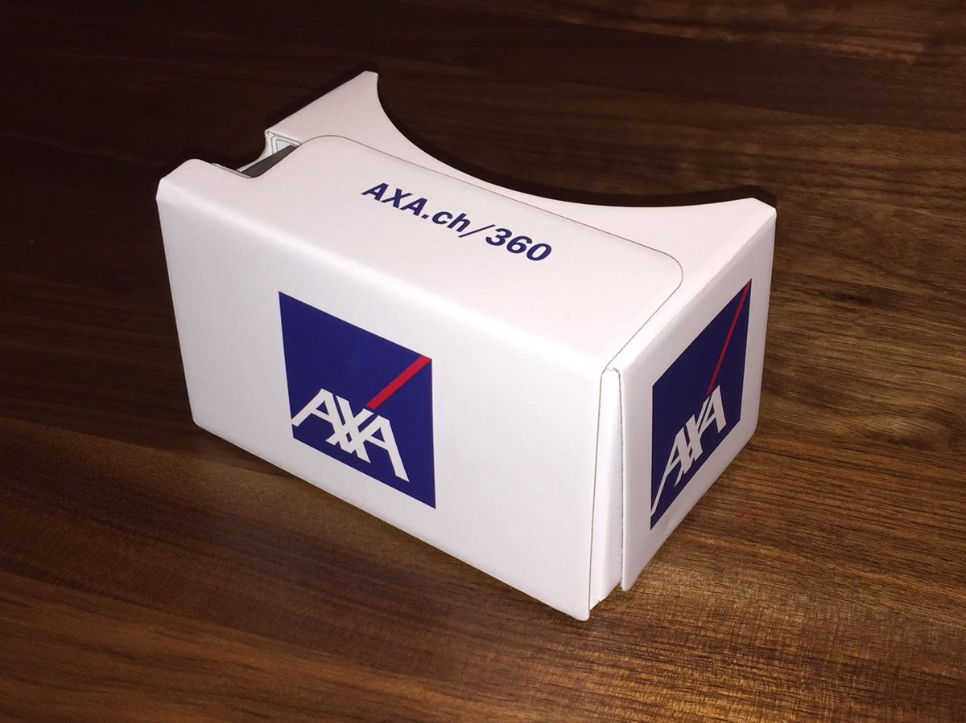
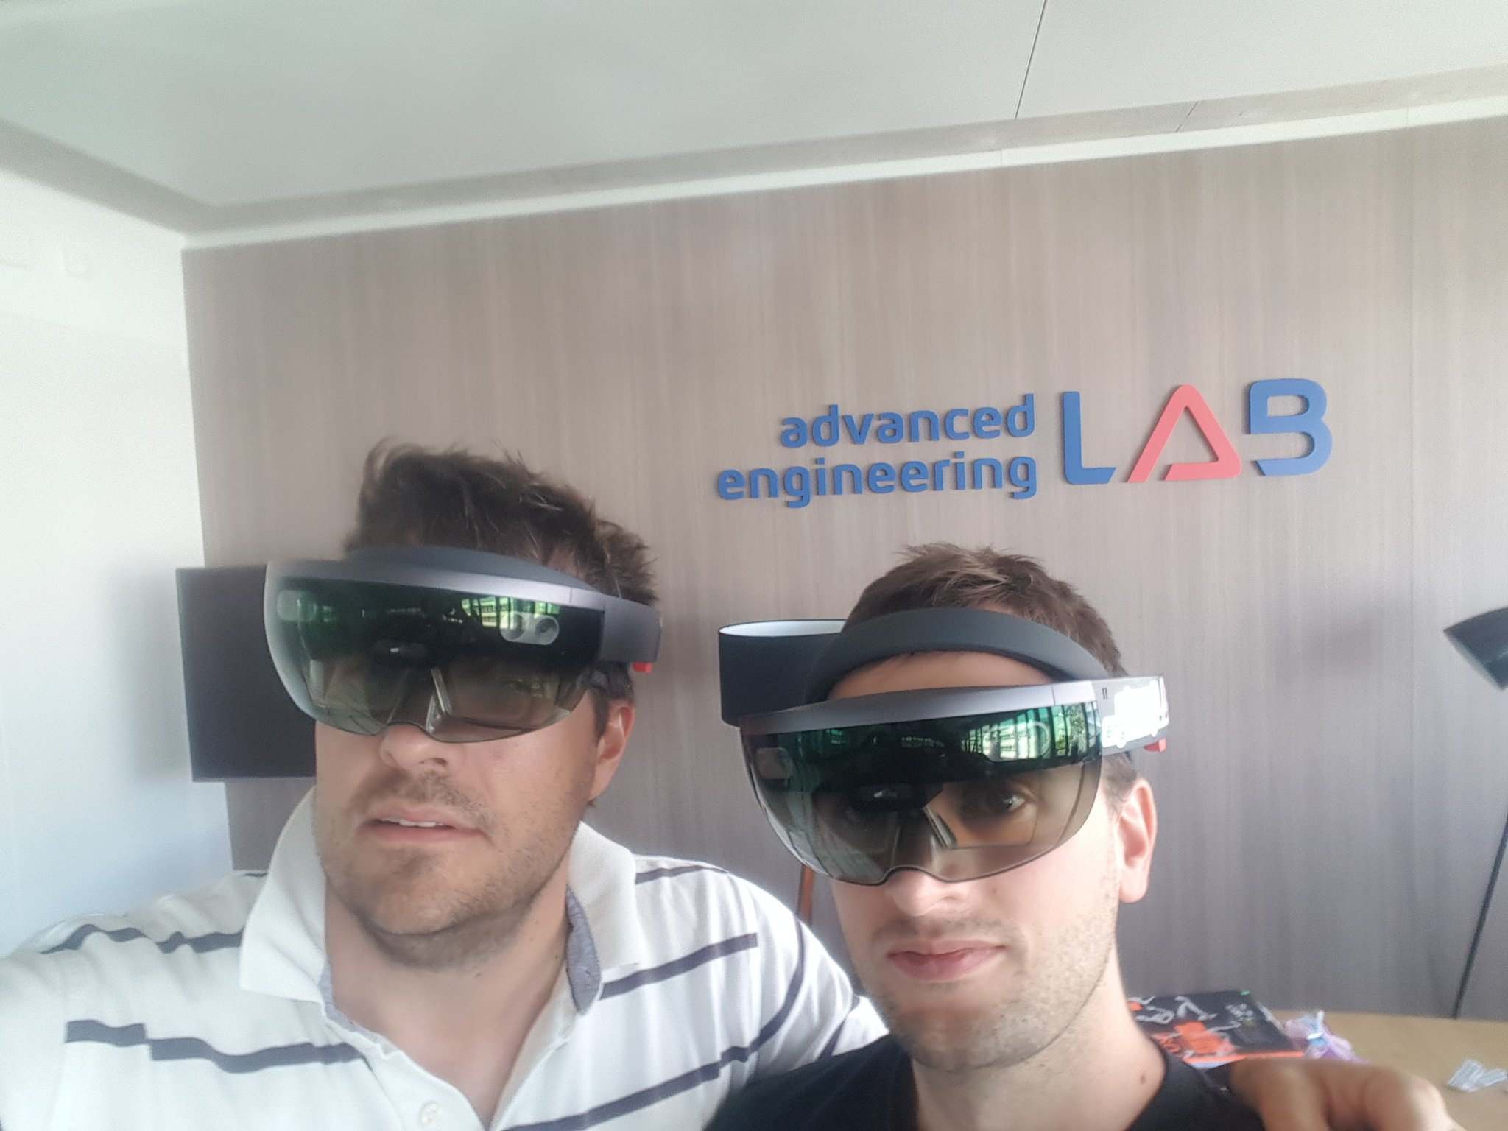
Insurance – As Simple as a Game
aka “Clash of Claims”

Slide 2
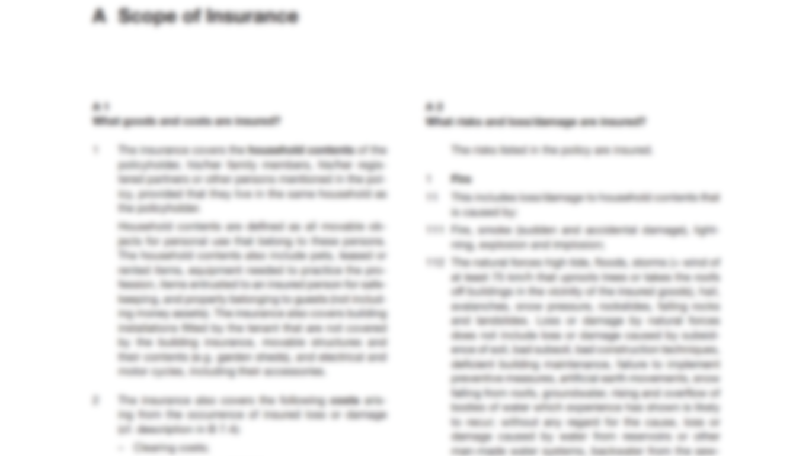


Insurance – is far too complex
NO FUN
48 pages legal terms in Arial 9
blurry
simplicity missing
too many options
User Interfaces
ugly & overloaded
black / white

Slide 3

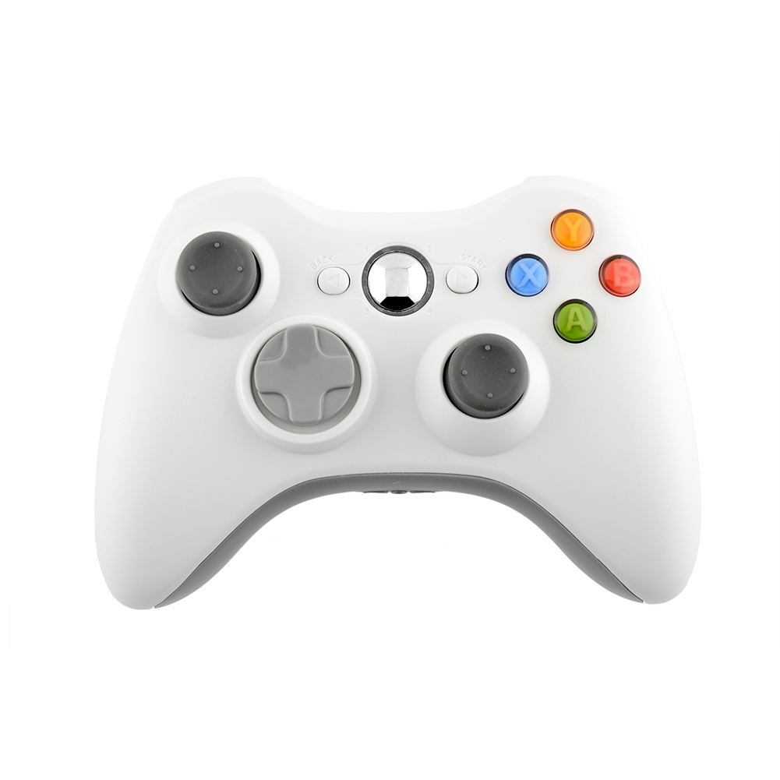
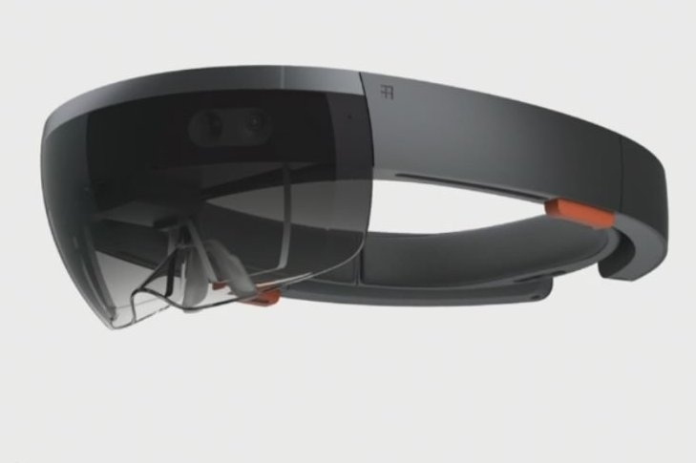
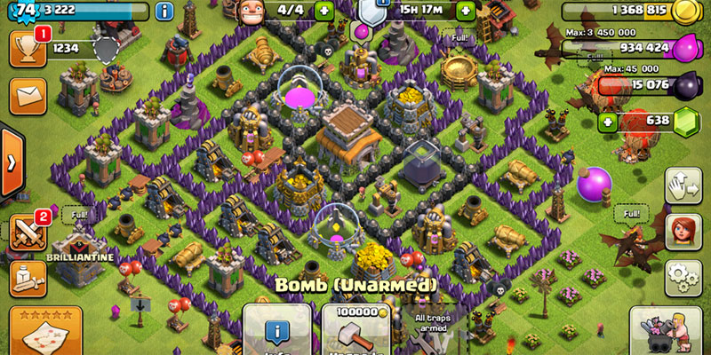

Games today – the opposite
interactive
FUN
colorful
simple for kids - seniors
holographic
complex, too.
But not from the beginning.

Slide 4


presents
"Insurance - As simple as a Game"
aka "Clash of Claims"
Show us
→ 1 New insurance interfaces as a Game
→ 2 Simplify: membership instead of premium
→ 3 Augmented reality interactions
→ 4 Insurance products within a Game

Slide 5

What is an insurance? (simplified)
Early insurance: merchants ~3000 BC used methods to minimize risks
European modern insurance: started at Great Fire of London in 1666 – damaged > 130’000 houses
Terms:
Provider: insurance
Buyer: insured
Contract: policy
Price: premium
Damage report: claim
Accept risks, give guarantees Underwriting
Object / Person / Assets
In a contract for a price
Coverage
Protection
Risk of Loss or Damage

Slide 6
What is an insurance? (simplified)
Examples of objects / person / assets
You and your family, friends, community
Your car, bike, ebike, motorbike
Your house, your rental
Your household
Your favorite objects (Mac, Smartphone, watch, jewlery)
Your travel
Your vacation
Your startup
Your employees
Your payments
….
Your Gamelevel
Your Pokémon’s
Your Clans
Object / Person / Assets
In a contract for a price
Coverage
Protection
Risk of Loss or Damage

Slide 7
What is an insurance? (simplified)
Examples of risks
File / elementary
Water
Burglary
Theft
Glass
Loss and damage
Liability – damage to a 3rd party
Health
Accidents
Death
Invalidity
Life
Object / Person / Assets
In a contract for a price
Coverage
Protection
Risk of Loss or Damage

Slide 8
1: new insurance interfaces
Our problem
UI’s are too complex, too fuzzy, to much complexity
Onboarding / start an insurance process is boring, time consuming and
Too many questions to ask
Games
Registration / onboarding is so simple
Millennials / juniors can do it
Your job?
Could we simplify the onboarding of a customer?
Could we create interactive registration like in a Game?
Could we use kind of Avatar to explain what has to be done?
Could we use Augmented Reality to simplify?
Important: simplify the insurance details / you are not an expert

Slide 9
2: Membership instead of premium
Our problem
We have 3 Line of Business, > 20 product branches, > 50 different insurance products: Grrrr !!
Each policy has its own price / premium / bill / letter / thank you mail …. Grrrr !!
No real online insurance
Not 1 insurance
Games
1 Game = 50 Levels
1 Membership you start with
Increase, buy more if you fail
Your job?
Could we just have 1 policy and 1 membership?
Could we add risks / coverages as simple as adding / buying a Level?
Could we decrease membership if no accident?
Could we increase if there is an accident?
Could we decrease membership while being in peer2peer community?

Slide 10
3: Augmented reality interactions
Our problem
Insurance is hard to see
Insurance is hard to touch
Insurance is hard to understand
Insurance needs advice from agents
Augmented Reality / AR
Makes things easy to see
Makes things touchable
Makes things interactive
Especially in Games
Your job?
Could we use AR to explain insurance?
Could we introduce an insurance agent as a Hologram?
Could AR help onboarding a customer with insurance? (see topic 1)
Could we use AR to capture a crashed car digitally?
Use our Hololens at the Booth
Use your Smartphones as an AR tool

Slide 11

4: Insurance products within a Game
Our problem
Insurance are insuring your real things – but is virtual
We insure your favorite objects and beloved ones (you, car, Mac, house, health, vacation, credit card) if something happens
And your Virtual ones in Games?
You also have virtual favorites
Your Pokémon, your Clans, your Fortress, your Army, yourself – but with 3 Life's, your car
Your job?
Could we create insurance for Your Clans? Your Pokémons?
Could we insure your Game Level?
Could we calculate the total damage produced in a Game? Life, Houses, …
Could we create virtual Insurance companies within a Game?

Slide 12
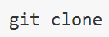
Our assets to you
Our API
Perfect Swagger Docu
> 200’000 elements running on Microsoft AZURE – SaaS
you get it all
Nodejs + mongodb + all data public available
Docu how to install and run
We support you
We are here for you during 40h – day and night
IT, tech and businss support
Come to our booth
Tell us where you are
Use our Hololens at our Booth to test your Augmented solution
https://hackzurich16.azurewebsites.net/

Slide 13
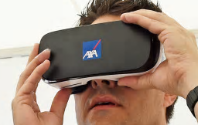
Winner price
"Insurance - As simple as a Game"
aka "Clash of Claims"
Winner
Winner: 4x Samsung S6 + Gear VR
Present your idea at AXAnauts Zero Gravity Event in Winterthur, 25th October 2016

Slide 14
"Insurance - As simple as a Game"
aka "Clash of Claims"
Have fun
Inspire us
Come to us

Slide 15
Thank you

Slide 16
Our Assets to you
"Insurance - As simple as a Game"
aka "Clash of Claims"
Featuring
→ "Insurance APIs" > 200'000 data elements (customers, profiles, cars, favorites, agencies, claims, contracts, …)
→ Swagger docu + Sandbox +
→ Virtual reality devices to use at our booth
→ Hololens to use at our booth
→ Insurance knowhow to support you

